Slide 1
Fusion API Overview
Texas Instruments Fusion Digital Power
Mike Muegel fusion-tools-help@list.ti.com
3 June 2012

Slide 2
Requirements
C# or Visual Basic.NET (VB.NET)
  Visual C# 2008 Express or Visual Basic 2008 Express (free!)
  Visual Studio 2008 ($$)
The API also has a number of UI oriented features:
  USB/device “discovery” forms
  Custom “editors” for most commands on a device (not covered in this presentation)
  Support tools such as firmware download, etc.
UI features require purchasing a copy of DevExpress’ DXperience WinForms (US$800 MSRP) for each developer
Knowledge of C# or VB.NET and basic object oriented programming techniques
Slide <number>

Slide 3
API Overview
Built using Micorosoft.NET technologies
Abstracts devices and commands that a device supports
Handles all bus communication through TI USB adapter (aka SAA)
Supports multiple devices and SAA adapters simultaneously
Simple, one line API calls to initialize the SAA adapter and find what device(s) are on the bus
Provides native “.NET way” of reading and writing commands
  Automatically converts device hex data to .NET representation
  Strings for MFR_MODEL, MFR_REVISION, etc.
  Double for VOUT_COMMAND, READ_IOUT, etc.
  Custom classes for other parameters
Slide <number>

Slide 4
API Overview
You just have to know what commands you are interested in, and the API does the work of reading/writing
But, you can always work at the “byte level”
  Write a hex value
  Access the hex value that was last read or written (caching)
Use the API to create:
  Stand-alone GUI programs
  Stand-alone console / command line programs (no GUI, universal “batch mode” capability)
  Your own classes/functions that can be called from other environments such as NI LabView, NI TestStand, MATAB, etc.
Slide <number>

Slide 5
Caveats
API has detailed class-level documentation using standard .NET XML comments
  Gives Intellisense as you use the API
  Examples:
But lacking is more detailed higher level documentation that “connects the dots”
This slide deck is a preliminary 20,000 ft view of the API
Different “overloads” of the current function
Description of the current function
Slide <number>

Slide 6
Caveats
The API currently requires many DevExpress assemblies for non-UI components of the API
TI will refactor the library to allow non-UI components of the API to be used without this dependency
Slide <number>

Slide 7
Microsoft.NET Framework Version
.NET Framework
  This is the Microsoft supplied set of core APIs
  Windows forms, I/O, RegEx, etc.
  There have been three versions of the Framework
The API is built against.NET Framework 2.0
While you could develop and target Framework 3.5, you would still need to ensure than Framework 2.0 (for Fusion API) and Framework 3.5 (for your application) are installed on the user’s PC
So we recommend your applications target Framework 2.0 as well
The installer system described later also assumes this, as it will only check for and install Framework 2.0
Slide <number>

Slide 8
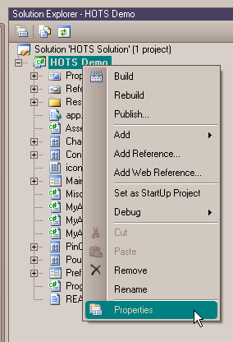
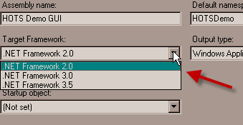
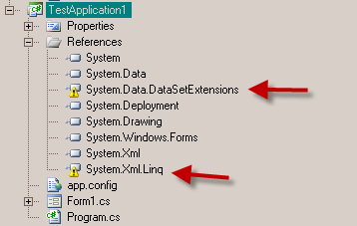
Changing Existing Project to Target .NET 2.0
Open project properties (right click project):
Then remove references to .NET 3.5 specific assemblies:
Or copy the ATMSystemGUI sample tree and use it for a starting point
Slide <number>

Slide 9
ATM System GUI Sample
This is a sample GUI created by TI
It provides OPERATION and manual LIGHT_LOAD control, along with basic monitoring, of up to four Isolated controllers
Shows how multiple devices can be access through the API
Uses simple WinForms timer to do “polling” of device readings
  Input: READ_VOUT, READ_POUT, READ_IOUT
  Output: READ_VIN, READ_PIN, READ_IIN
The API also has built-in support for true background, threaded polling
  This is the method the Fusion GUI uses
  Supports automatic locking to handle thread contention
  See PMBusDevice.Start_Polling() and PMBusDevice.Stop_Polling()
Shows creating aggregate readings from individual readings:
  Total Output Power = SUM(Device1.READ_POUT + Device2.READ_POUT + …)
Source code has detailed comments
Slide <number>

Slide 10
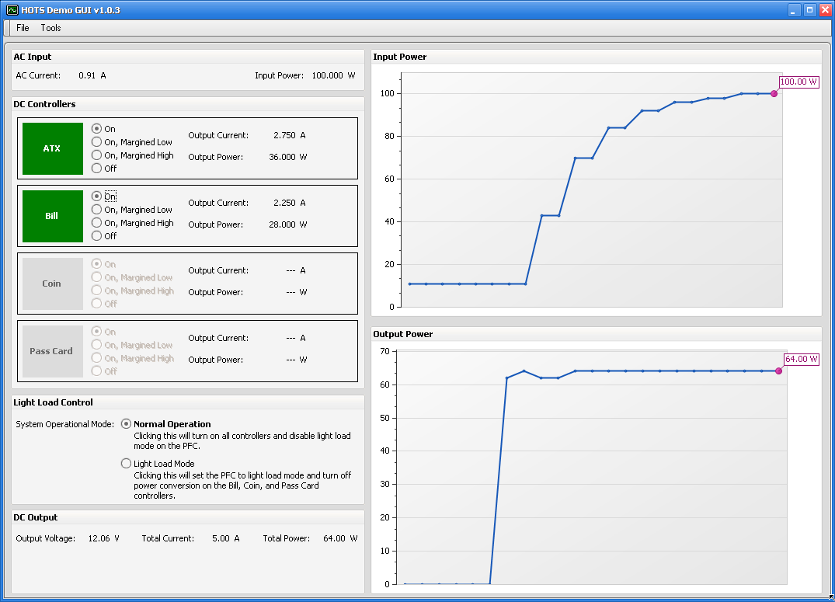
ATM System GUI Sample
Slide <number>

Slide 11

Creating a GUI Installer
The ATM System GUI Sample contains a system to create a self extracting Installer for the application
Uses free Inno Setup package to create installer
Download and install Inno Setup Quick Start Pack
Be sure to install ISTool. It provides a much better ISS file editor (ISTool)
When an installer created by this system is run, it will automatically download and install the .NET Framework 2.0 if not already installed on the user’s PC
  Only if connected to a network
  Uses Internet Explorer proxy settings, so should work through most Corporate firewalls
Edit “Inno Setup Installer.iss” file in the Installer directory as appropriate
  Double clicking the iss file will launch the ISTool editor
  Change version numbers at top of the script when you do a new release (or via
  Also supports custom license agreement, shortcuts, etc.
  To create the actual installer, click the compile button:
Slide <number>

Slide 12
Texas Instruments Support
We can not provide C#, VB.NET, or .NET training or support
  We recommend seeking a multi-day .NET WinForms training course
Samples and API are provided “as is” with no warranty
We will strive to answer questions about the API, but response time may not be on the level we provide for our devices
Slide <number>

Slide 13
Fusion Tools & API Overview
Applications
Designer GUI
(aka Fusion GUI)
Factory GUI
Command Line Tools
TI Device Test Tools
Customer Tools
Configure, monitor, design UCD controllers and sequencers
Supports 14 unique devices
DigPower: UCD91XX, UCD92XX, Isolated
Other: TPS41000/40400, Trojan sequencer
Automate manufacturing oriented tasks such as configuration, calibration, and test
Out-of-the box supports full EVM build process for UCD91XX and UCD92XX
Customer extensible via plug-in framework
Come bundled with Fusion Digital Power Designer
Write project file, read device values, write select commands, etc.
Can be integrated into any test/MFR executive
“Device Tester”
Internally developed device test tools such as Smarty Jones validation scripts developed by SJ team
Texas Instruments Fusion API
Other APIs
PMBus
USB Adapter
Factory
Instrumentation
.NET Framework
Developer Express
Dundas Chart
Open Source / Free
Abstracts every device/command the Fusion GUI supports
High-level R/W: VOUT_COMMAND.
Write(1.1)
Low-level R/W: WriteWord(0x21, 0x08CC)
Project file read/write
Firmware download
Design tool: compensation, loop response, time model
Etc. …
Set up to 5 control lines
Make arbitrary SMBus calls
Standard “factory” tasks such as calibration
Prompt operator for input
Log a message
Indicate progress
Etc …
High-level API to IEEE 488 controlled test equipment
Set load, set power, read current, etc.
Windows forms
I/O
RegEx
Etc …
Commercial User Interface toolkit
Also has graphing control (used in ATM System demo)
Must purchase license to use graphical components of the Fusion API, as it is built on top of DevEx
Commercial charting control
Used in Designer GUI
Sharp3D (complex number math)
Etc.
Slide <number>

Slide 14
Key Classes
SMBusAdapter – perform operations on the USB adapter aka SAA
PMBusDevice – abstracts a device (UCD9240, TPS40400, EVMTTIF00, etc.)
PMBusCommands – abstracts the commands a device supports
PMBusCommand – abstracts a command (CLEAR_FAULTS, READ_IOUT, OPERATION, etc.)
ParameterBase – abstracts a parameter, which is a command you can read and/or write to (all of previous except for CLEAR_FAULTS)
Slide <number>

Slide 15
Device/Command Object Hierarchy (Simplified)
SMBusAdapter Class
PMBusDevice Class
Adapters
Devices
A list of devices found when Discover() was called
Devices[0]
Devices[1]
…
These are PMBusDevice instances
Many properties and methods to perform device level operations, get information about the device, etc
Adapter
Commands
A list of commands the device supports
This is a PMBusCommands instance
READ_VOUT
OPERATION
CLEAR_FAULTS
…
These are PMBusCommand sub-class instances
Each command will be customized according to what it can do: read-only, read-write, what data it reads/writes, etc.
Very STRONGLY TYPED, with custom .NET data interfaces to every command, including device MFR proprietary commands, the API supports.
This allows API users and the GUI itself to work with data at a higher level, letting the API worry about how to encode and decode the data to/from the device
Device.Commands.VOUT_COMMAND().Write(1.5);
double? vout_reading = Device.Commands.READ_VOUT().Immediate;
string mfr_model = Device.Commands.MFR_MODEL().Latest;
Device.Commands.MFR_ID().Write(“ACME”);
var status_word = Device.Commands.STATUS_WORD().Immediate;
if (status_word.Num_On > 0)
Console.WriteLine(“there are faults on the device: “ +
status_word.ToString();
Slide <number>

Slide 16
Adapter/Device Discovery
Programs need to bootstrap the API by calling static methods that find USB adapters (aka SAA) attached to the PC and, optionally, find any devices on the PMBus and create Device instances for those found
Lots of ways to do it; lowest level is:
  SMBusDevice.Discover(): find USB adapters
  PMBusDevice.Discover(): find devices on the bus; SMBusDevice.Discover() must be called first
Higher level wrappers:
  PMBusUtils.Attach_And_Discover(): use for console programs, returns # devices found
  PMBusUIUtils.Attach_And_Discover(): use for WinForms programs, returns enum specifying whether a device was found or the user decided to quit
Options exist to:
  Configure the SAA (PEC mode, bus speed)
  Specify PMBus addresses to scan first and # devices to limit the discovery to, thus allowing for faster startup (i.e. I expect my device to be at address 12 or 13, so scan this first and return if you find one device)
Slide <number>

Slide 17
Parameter Data Caching
Commands keep cached copy of last data read or written successfully
This is available in the Latest (.NET version of data) and Latest_Encoded (raw byte data) properties
Accessing Latest or Latest_Encoded will cause the API to read from the device if it has never been read
You can force the cache for all commands to be cleared calling Device.Clear_Parameters()
The Immediate property forces a read from the device every time
Or you can call Refresh()
Write(data) will only perform a write if the cached Latest value differs from what was passed to Write; you can force the write by calling Write_Force(data)
Slide <number>

Slide 18
Encode / Decode
On read, the API automatically handles decoding the raw PMBus data into the underlying parameter type (double, int, a custom class, etc)
But you can access the raw data via the Latest_Encoded property
This will be one of:
  PMBusByte (1 byte)
  PMBusWord (2 bytes)
  PMBusBlock (1 to 32 bytes)
The ToString() of these pretty print them 0xAABB… style
You can also write “encoded” data via Write_Encoded() and Write_Encoded_Forced(); for example, it may be easier for you to specify an OPERATION command value to write via it’s hex vs. setting up an OperationCommand instance
These are equivalent:
  Device.Commands.ON_OFF_CONFIG().Write_Encoded(0x00);
  var on_off_config = new OnOffConfig();
  on_off_config.Power_On_Mode = OnOffConfig.PowerOnMode.Always;
  Device.Commands.ON_OFF_CONFIG().Write(on_off_config);
The API automatically creates Lastest_Encoded after the first version and Latest after the second
Latest_Formatted_Plus_Encoded returns a nicely formatted version of the decoded and encoded version of Latest and Latest_Encoded:
  A voltage command: “1.500 V [0x1800]”
  OPERATION: “Unit: On; Margin: None (IgnoreFault) [0x84]”
  MFR_SERIAL: “ABC123 [0x414243313233]”
Slide <number>

Slide 19
Strongly Typed
Latest, Immediate, Write, etc. work with .NET representations of the data read and/or written to the device
  For example:
    double? – used for floating point numbers
    int?, byte?, etc. – used for fixed point numbers
    OnOffConfig – ON_OFF_CONFIG
    PinPolarity Control_Pin_Polarity { get; set; }
    ControlPinTurnOff Control_Pin_Turn_Off { get; set; }
    PowerOnMode? Power_On_Mode { get; set; }
    FaultResponse - VIN_UV_FAULT_RESPONSE, VIN_OV_FAULT_RESPONSE, etc.
    Etc.
Slide <number>

Slide 20
Error Handling – Status Mode
By default, the API returns status codes or some “null” value from operations that interact with the device over PMBus
  For example:
    Write(), Write_Encoded(), Write_Force(), Write_Encoded_Force() – return true on success
    if (!Device.Commands.OPERATION.Write_Encoded(0x00))
    Console.WriteLine(“error turning OPERATION off: ” + Device.Commands.OPERATION.()Last_PMBus_Status_String);
    Immediate, Latest – returns “null” value on error
    var fault_resp = Device.Commands.VIN_UV_FAULT_RESPONSE().Latest;
    if (fault_resp == null)
    return;
    else
    ConsoleApp.WriteLine("VIN_UV_FAULT_RESPONSE is {} [{}]",
    fault_resp, Device.Commands.VIN_UV_FAULT_RESPONSE().Latest_Encoded);
PMBusCommand Last_Status property also provides status of last command (boolean) and Last_PMBus_Status_String provides a brief description of the actual error (usually “NACK”).
For many applications, this error model is cumbersome: lots and lots of error checking if you really want to check all device I/O
Slide <number>

Slide 21
Error Handling - Exception Mode
Alternative is to set exception mode by setting PMBusDevice.Exceptions_On_SAA_Error = true
This is a static property and sets this mode globally for all devices and operations that go through the USB adapter
Review Exceptions
You could put a try/catch around areas you except to be problematic, or let exceptions bubble up
Example of catching:
try
{
Device.Commands.VOUT_COMMAND(0).Write(1.0);
Device.Commands.VOUT_COMMAND(1).Write(1.5);
Device.Commands.VOUT_COMMAND(2).Write(3.3);
Device.Commands.VOUT_COMMAND(3).Write(3.3);
ConsoleApp.WriteLine(“set test voltage on all rails”);
}
catch (Exception ex)
{
// ex will contain a friendly string like
// “UCD9240 @ Address 88 VOUT_COMMAND [Rail #2] Write(1.5): NACK”
ConsoleApp.WriteLine(“error setting test output voltage: {}”, ex);
}
Slide <number>

Slide 22
More Command Details
What’s the deal with double?, int?, etc?
  This represents a “nullable type”
  Latest and Immediate return these types because, when there is a read error, null is returned
  Example in standard status mode:
  double? temp =
  Device.Commands.READ_TEMPERATURE_2().Immediate;
  if (temp == null)
  ConsoleApp.WriteLine(“error reading temp”);
  else if (temp.Value > 35)
  ConsoleApp.WriteLine(“temp is too high @ {}”, temp);
  temp.Value accesses the non-null version (a double in this example)
  If you are using exception mode, you can just ignore this and use the non-null version directly, since you are guaranteed that the read succeeded if you got to that point:
  double temp =
  Device.Commands.READ_TEMPERATURE_2().Immediate.Value;
  if (temp > 35)
  ConsoleApp.WriteLine(“temp is too high @ {}”, temp);
Slide <number>

Slide 23
More Command Details
PAGEd
  Some devices, like the UCD92XX family of devices, support more than one rail
  But there are still only one set of PMBus commands to work with these: i.e. there is no VOUT_COMMAND_1, VOUT_COMMAND_2, etc.
  The PMBus PAGE command is used to tell the device which rail a command is targeting
  On the API-side, the API maintains separate instances of each PAGEd command, each with it’s own Latest cache, status, etc.
  You access the rails by passing the PAGE index (0 based) like so:
  // Read rail #4’s READ_IOUT
  double? read_iout = Device.Commands.READ_IOUT(3).Immediate;
What about “SendBytes”?
  Commands like CLEAR_FAULTS and STORE_DEFAULT_ALL do not have any data: they are an SMBus “SendByte”
  To initiate these, invoke the Execute() method
Slide <number>

Slide 24
Events
Static (global) events that are fired for every single device discovered and every command
  Key events
    OperationExecute: a SendByte was performed; for example, CLEAR_FAULTS
    ReadParameter: any read has occurred, even if no update
    WriteParameter: any write has occurred, even if no update
    UpdatedParameter: this lets you limit notification to when a command has a new value read or written!
  Event “args” provides detail about the device/command/etc.
  if (e.ID == CommandID.READ_IOUT)
  {
  ConsoleApp.WriteLine("Wrote {} to {}",
  e.Parameter.Latest_Formatted_Plus_Encoded, e.Parameter);
  }
Instance events that are fired only for a specific command on a specific device
  Key events:
    NewValueRead: new value read
    Wrote: wrote command, even if no update
    Updated: a new value was written to or read from the device
There are also events at other levels, such as a Device
Slide <number>

Slide 25
SMBusAdapter
There is one of these for each USB adapter (aka SAA) that is attached to the PC
So usually one, but the API does support multiple adapters
SMBusDevice.Adapters and PMBusDevice.Adapters (both static) contains all of them (reference the same adapter list)
Device.Adapter (instance) is a reference to the adapter a single device is attached to
You will normally only need to use the Adapter to do non-PMBus things, like:
  Get/set state of the primary control line
    LogicLevel logic_level = Device.Adapter.Get_Control();
    Device.Adapter.Set_Control(LogicLevel.High)
  Get/set the state of one of auxilliary control lines
    Lines are numbered 1 through 5
    LogicLevel logic_level = Device.Adapter.Get_Control(2);
    Device.Adapter.Set_Control(2, LogicLevel.Low)
  Set the bus speed or PEC mode
    Device.Adapter.Set_Bus_Speed(BusSpeed.SMBusAdapter.Speed400KHz)
    Device.Adapter.Set_PEC_Enabled(true)
Slide <number>

Slide 26
SMBusAdapter
But you could also bypass discovering a device via the PMBus API and instead just use the lower level SMBusAdapter instead
// Discover adapter(s); SMBusAdapter.Adapter is the first one found,
// but all adapters are available in SMBusAdapter.Adapters list
  if (SMBusAdapter.Discover() == 0)
  ConsoleApp.CDie("could not find a USB adapter attached to the PC");
  // The following show operations on device at address 127 and assume
  // that exception mode has been turned on, so we don’t check for errors
  // Write a block to command code x9E
  SMBusAdapter.Adapter.Write_Block(127, 0x9E, "0x3231");
  // Perform a “SendByte” on command code x03
  SMBusAdapter.Adapter.Send_Byte(127, 0x03);
  // Read a word and fetch hi/lo byte on command code x23
  var result = SMBusAdapter.Adapter.Read_Word(127, 0x23);
  ConsoleApp.WriteLine("Read Word hi=0x{:X2}, lo={:X2}",
  result.Data.Hi_Byte, result.Data.Lo_Byte);
Slide <number>

Slide 27
SMBusAdapter
If you had previously discovered the device, you can access low-level SMBus commands via your Device object:
  ByteEncodedResult SMBus_Read_Byte(byte code)
  WordEncodedResult SMBus_Read_Word(byte code)
  BlockEncodedResult SMBus_Read_Block(byte code)
  SAAStatus SMBus_Send_Byte(byte code)
  SAAStatus SMBus_Write_Byte(byte code, byte data_byte)
  SAAStatus SMBus_Write_Byte(byte code, PMBusByte data_byte)
  SAAStatus SMBus_Write_Word(byte code, byte hi_byte, byte low_byte)
  SAAStatus SMBus_Write_Word(byte code, PMBusWord data_word)
  SAAStatus SMBus_Write_Word(byte code, string hex)
  SAAStatus SMBus_Write_Block(byte code, byte[] data_bytes)
  SAAStatus SMBus_Write_Block(byte code, PMBusBlock data_block)
But these operations are not synced to the PMBus API; so avoid unless the PMBus API does not support a particular command on the device
Slide <number>

Slide 28
Much More to the API
Almost everything in the GUI has an API equivalent
  Project file save/import
  Data flash import/export
  Configuration export as CSV/text table
  Firmware download
  Calibration routines
  Run loop response on given power stage, compensator
ConsoleSample1 has some examples of above
So if you see something in the GUI and would like access to it from your own tool, just ask!
Slide <number>

